Slide 1

INTERNET PROGRAMMING & MOBILE PROGRAMMING
PROJECT 3: Crowdsensed Drive Test Mobile Application for Coverage Prediction
GROUP MEMBERS
1
Asangana Paul Fleming
FE23A014
2
Fontem Junior Nkonganyik
FE23A063
TASK 6
3
Suinyuy Mathias Mahla
FE23A144
Database Design
& Implementation
4
Nfor Godwill Kongnje
FE23A108
5
Ronald Namwene Vefonge
FE22A295
GROUP 10
University of Buea

Slide 2

Introduction — Purpose of the Database
INTRO
Serving as the backbone for crowdsensed network data collection, storage, and analysis
What the database does:
Anonymous
Offline-First
Unlike traditional drive testing requiring expensive hardware, this system relies on ordinary smartphones to collect network measurements. The database stores, organizes, manages, and processes large volumes of crowdsensed data — all without storing any personal user information.
No user accounts or personal data stored
SQLite buffers data without connectivity
Auto-Sync
Coverage Analysis
"The database does not store personal user information — instead it focuses on anonymous device-generated measurements while maintaining user privacy."
Queues and uploads on reconnection
Scores and classifies network quality
Flutter
SQLite
Node.js
MySQL
Hole Detection
Alert System
Maps weak signal geographic regions
Info, Warning, and Critical notifications

Slide 3

Data Elements — Device Information
DATA ELEMENTS
Anonymous device identification without storing personal user data
Since the system operates anonymously, device information uniquely identifies data sources without exposing personal user information.
Device ID
1
Uniquely identifies a sensing device. Prevents duplicate records. Enables tracking of measurement origins.
Device Model
2
Allows comparison across device types. Supports hardware-specific analysis. (e.g. Samsung Galaxy A55, Redmi Note 13, Tecno Camon 30)
OS Version
3
Supports compatibility analysis. Assists debugging. (e.g. Android 12, Android 13, Android 14)
Application Version
4
Tracks which software version generated measurements. Supports update management.

Slide 4

Data Elements — Network Measurements
DATA ELEMENTS
The most critical data collected — cellular signal metrics from smartphones
Network measurements are the core of the system. Every coverage analysis and prediction depends entirely on these crowdsensed metrics.
RSRP
Cell ID
Reference Signal Received Power
Base Station Identifier
Measures signal strength. Primary indicator for coverage quality.
Identifies the serving cellular base station for each reading.
RSRQ
Network Type
Reference Signal Received Quality
Technology Generation
Evaluates signal quality relative to interference.
2G / 3G / 4G LTE / 5G — enables network tech analysis.
RSSI
Timestamp
Received Signal Strength Indicator
Collection Time
Measures total received radio power including noise.
Records exactly when each measurement was captured.
SINR
Signal-to-Interference-plus-Noise Ratio
Indicates network quality level and interference presence.

Slide 5




Data Elements — Geographical, Storage, Analysis & Alerts
DATA ELEMENTS
Remaining 4 data categories supporting location, offline operation, and reporting
Geographical
Temporary Storage
▸ Latitude — Geographic position
▸ Temp Record ID — Identifies local records
▸ Longitude — Geographic position
▸ Storage Time — When data was stored offline
▸ Altitude — Terrain-based analysis
▸ Sync Status — Pending / Uploaded / Failed
▸ Speed — Moving vs. stationary detection
▸ GPS Accuracy — Location reliability
Coverage Analysis
Alert Data
▸ Analysis ID — Identifies each analysis
▸ Alert ID — Identifies the alert
▸ Coverage Score — Numerical quality rating
▸ Alert Message — Network condition interpretation
▸ Classification — Good / Acceptable / Poor
▸ Alert Type — Information / Warning / Critical
▸ Analysis Timestamp — When analysis ran

Slide 6


Conceptual Database Design — 8 Core Entities
CONCEPTUAL
Major components and their responsibilities within the crowdsensing system
Device
Measurement
Location
Temporary Storage
The primary identifiable source of measurements. Generates, stores, and syncs data.
Central entity. Stores RSRP, RSRQ, RSSI, SINR, Cell ID, and timestamps.
GPS coordinates tied to each measurement. Enables coverage mapping.
SQLite buffer for offline-collected records. Prevents data loss.
Synchronization Log
Coverage Analysis
Coverage Hole
Alert
Tracks upload attempts, counts, and outcomes per device.
Scores and classifies network quality from raw measurements.
Maps geographic regions with poor signal, including severity level.
Admin-generated notifications with type classification.

Slide 7
Entity Relationships & Cardinalities
CONCEPTUAL
How entities connect and interact — cardinality defines data flow rules
Entity A
Cardinality
Entity B
Relationship Description
Device
1 : N
Measurement
A device generates many measurements over time.
Device
1 : N
Sync Log
A device performs many synchronization attempts.
Measurement
1 : 1
Location
A measurement is recorded at exactly one location.
Measurement
1 : 1
Temp Storage
A measurement may be buffered in temporary storage pending upload.
Measurement
1 : 1
Coverage Analysis
A measurement is evaluated by one coverage analysis.
Coverage Analysis
1 : N
Coverage Hole
One analysis may identify multiple coverage holes.
Coverage Analysis
1 : N
Alert
One analysis may trigger multiple alerts.
1:N = One-to-Many
1:1 = One-to-One

Slide 8
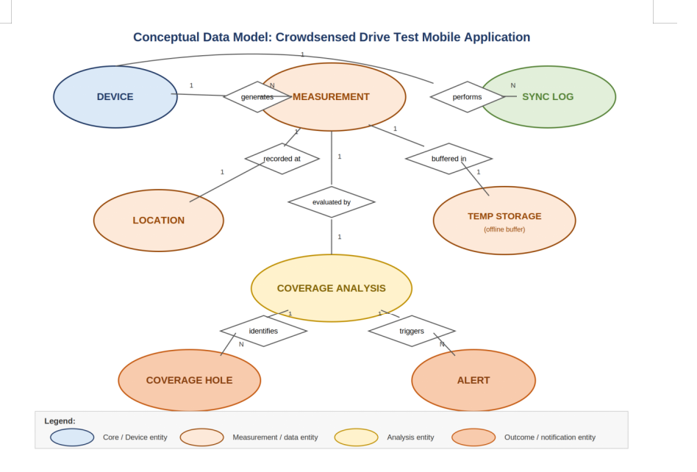
Conceptual ER Diagram
CONCEPTUAL
Entity–Relationship notation: Entities as ellipses, Relationships as diamonds, Cardinalities on lines
The conceptual diagram below visually represents all 8 entities, 7 relationships, and their cardinalities. This serves as the blueprint before physical database implementation.
📷 Conceptual ER Diagram (Ellipses + Diamonds + Cardinalities)
[ Insert Screenshot Here ]

Slide 9
Entity Relation Diagram — Tables 1 to 4
ERD
Physical table definitions derived from the conceptual ER model
Device
Measurement
Stores anonymous device information.
Stores crowdsensed network measurements.
device_id (PK)
device_model
os_version
app_version
created_at
measurement_id (PK)
device_id (FK)
rsrp
rsrq
rssi
sinr
cell_id
network_type
timestamp
Location
Temporary Storage
Stores GPS coordinates linked to measurements.
Buffers offline measurements for later sync.
location_id (PK)
measurement_id (FK)
latitude
longitude
altitude
speed
accuracy
temp_id (PK)
measurement_id
sync_status
storage_time

Slide 10
Entity Relation Diagram — Tables 5 to 8
ERD
Remaining tables for synchronization, analysis, holes, and alerts
Synchronization Log
Coverage Analysis
Tracks uploads and synchronization events.
Stores processed network quality results.
sync_id (PK)
device_id (FK)
sync_time
upload_count
sync_status
analysis_id (PK)
measurement_id (FK)
coverage_score
coverage_status
analysis_time
Coverage Hole
Alert
Records weak network regions with severity.
Stores admin notifications and alert messages.
hole_id (PK)
analysis_id (FK)
latitude
longitude
severity
detected_time
alert_id (PK)
analysis_id (FK)
title
message
alert_type
created_at

Slide 11
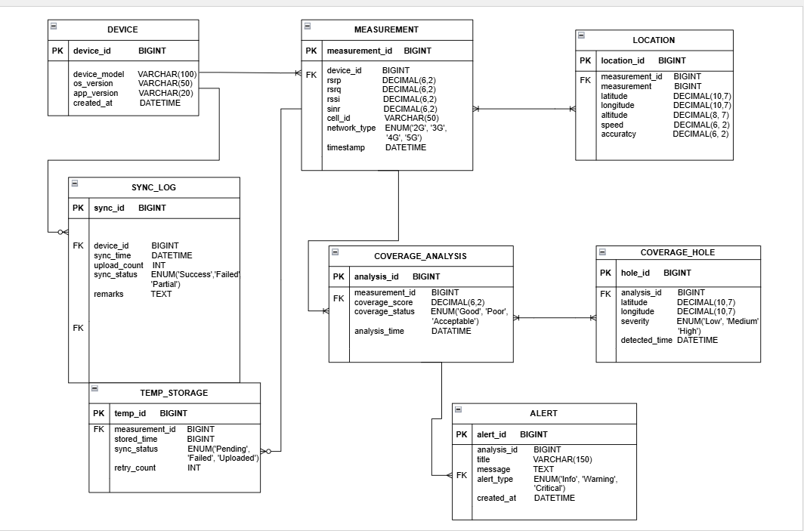
ERD → MySQL Implementation
ERD
Each entity becomes a MySQL table with PK/FK constraints for referential integrity
The ER Diagram served as the blueprint. Each entity → MySQL table. Relationships → foreign keys. Normalization applied to reduce redundancy.
📷 MySQL ERD / Database Schema Diagram
[ Insert Screenshot Here ]

Slide 12
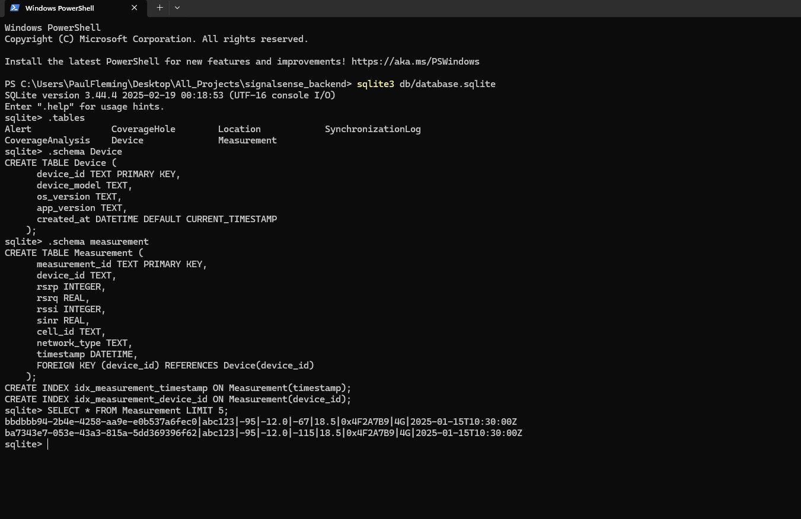

Offline Storage with SQLite
IMPLEMENTATION
Continuous data collection even without internet connectivity
1
Device Goes Offline
Internet connectivity lost. Measurements continue to be collected.
2
SQLite Stores Data Locally
📷 SQLite Database Structure
Measurements, Location, Timestamps, and Sync Status saved to local DB.
[ Insert Screenshot Here ]
3
Auto-Sync on Reconnection
Synchronization module automatically uploads pending records to server.
Key Benefit: Zero Data Loss
No measurement is ever discarded — even in areas with zero connectivity. SQLite ensures uninterrupted crowdsensing as users travel between regions.

Slide 13



Backend Implementation — Node.js
IMPLEMENTATION
Event-driven, asynchronous architecture for high-volume crowdsensed data
Backend Responsibilities:
High Scalability
Real-Time Processing
Receive crowdsensed measurements
Handles thousands of simultaneous device requests without degradation.
Continuously processes incoming measurements from sensing devices.
Validate incoming data
Process measurement records
RESTful API
Efficient Resources
Store measurements in MySQL
Endpoints for: Upload, Retrieval, Synchronization, Analysis, Alert Generation.
Asynchronous architecture minimizes consumption, maximizes throughput.
Execute coverage analysis
Detect coverage holes
Generate alerts
Provide data to Flutter front-end

Slide 14

Complete System Workflow
IMPLEMENTATION
End-to-end data flow: Smartphone → SQLite → Node.js → MySQL → Coverage Maps & Alerts
1
Smartphones collect network measurements
2
Measurements stored in SQLite (offline)
3
SQLite queues unsynchronized records
↓
4
On reconnection — upload to Node.js APIs
5
Node.js validates & processes received data
6
Measurements permanently stored in MySQL
↓
7
Automated coverage analysis performed
8
Coverage maps & holes identified
Reports generated & alerts sent to users
📷 Flutter API Service Class
9
[ Insert Screenshot Here ]

Slide 15
CONCLUSION
Operational Architecture
Reliable Offline Collection
The ER Diagram was successfully transformed into a fully operational MySQL database capable of supporting large-scale crowdsensed network monitoring.
SQLite ensures zero data loss during offline periods — measurements continue to be captured and queued regardless of connectivity.
Scalable Node.js Backend
Complete System Integration
Node.js handles high-volume measurements in real time, executes automated coverage analysis, and manages communication across all components.
Flutter + SQLite + Node.js + MySQL delivers a robust, cost-effective alternative to traditional drive testing for continuous network monitoring.
Flutter
Dart
SQLite
Node.js
MySQL
REST APIs

